Slide 1

Computer Programming for Engineers
Week 1 Lecture 2
Week 1 Lecture 2
Sep. 1, 2022
Lecturer: Mohammad Mahdi Javidan
College of Engineering, Sungkyunkwan University
Fall Semester 2022

Slide 2
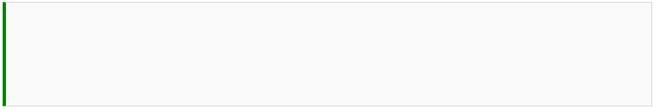



Variables and Assignment
Variables names:
may contain letters, digits (0-9) or the underscore character _.
must begin with a letter from A-Z or the underscore _ character.
Either lowercase or uppercase letters are acceptable.
Variable names cannot be a reserved word in Python.
Variable names are case-sensitive
College of Engineering, Sungkyunkwan University

Slide 3

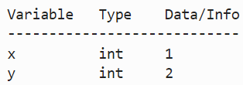
Variables and Assignment
List of variables %whos
Don’t mistake expressions in programming for mathematical expressions
(e.g. meaning of equality, parametric behavior)
You can delete a variable using the del function and all variables using %reset
College of Engineering, Sungkyunkwan University

Slide 4








Data Type - String
A string is sequence of characters surrounded by single or double quotation marks.
Check the length of a string using len
Using string indices
Slice the character from index 6 to 10
From the 7th character to the 10th
From the 1st character to the 4th
From the 7th character till the last
College of Engineering, Sungkyunkwan University

Slide 5






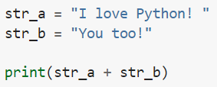
Data Type - String
From the 6th character to the second to the last
Taking every other character starting from the 1st character
Taking every 3rd character starting from the 3rd character
Use backslash for apostrophe
Concatenating strings
College of Engineering, Sungkyunkwan University

Slide 6




Data Type - String
Converting number to string
Accessing functions of the string object
Counting the number of a character
Replacing some characters
Printing without concatenation
College of Engineering, Sungkyunkwan University

Slide 7











Data Type - List
A list is defined using []
Lists can contain different variable types
Lists can be nested
Elements of a list can be accessed similar to strings
College of Engineering, Sungkyunkwan University

Slide 8









Data Type - List
Appending an element to a list
Inserting an element at a specific position
Deleting an element by index
Appending an item to an empty list
College of Engineering, Sungkyunkwan University

Slide 9



Data Type - List
Checking an element in a list
Turning a string to a list of characters
College of Engineering, Sungkyunkwan University

Slide 10






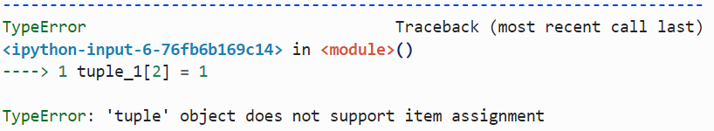
Data Type - Tuples
A tuple is defined using ()
Tuples can be handled using similar ways for strings and lists
Counting a number
Unlike lists, tuples are immutable
College of Engineering, Sungkyunkwan University

Slide 11


Data Type - Tuples
Tuples usually contain heterogeneous elements
Lists usually contain homogeneous elements
Defining a tuple by unpacking
* the number of elements on the two sides has to be the same
Defining a tuple by packing
College of Engineering, Sungkyunkwan University

Slide 12




Data Type - Set
You can define sets in Python! an unordered collection with no duplicate element. It even supports mathematical operations like union, intersection, difference, and symmetric difference.
You can find unique elements in a list, string, or tuple
College of Engineering, Sungkyunkwan University

Slide 13
Data Type - Set
Intersection
union
difference
symmetric_difference
College of Engineering, Sungkyunkwan University

Slide 14







Data Type - Dictionary
dictionaries are indexed by keys, which could be a string, number or even tuple (but not list). A dictionary is a key-value pairs, and each key maps to a corresponding value
Elements are stored without order, we need to use the key of the element
College of Engineering, Sungkyunkwan University

Slide 15





Data Type - Dictionary
dictionaries are indexed by keys, which could be a string, number or even tuple (but not list). A dictionary is a key-value pairs, and each key maps to a corresponding value
Changing a list of tuples to dictionary
Checking whether a key exists
Checking whether a key doesn’t exists
Changing a dictionary to a list
College of Engineering, Sungkyunkwan University

Slide 16

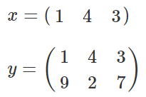






Data Type - numpy
a powerful N-dimensional array object which is important in scientific computing
Finding rows and columns of a matrix and its total size
College of Engineering, Sungkyunkwan University

Slide 17


Data Type - numpy
Increment
Generating a sequence of numbers with a specified increment
Generating a specified number of evenly distributed elements between two numbers
College of Engineering, Sungkyunkwan University

Slide 18








Data Type - numpy
Get the last column of array $y$
College of Engineering, Sungkyunkwan University

Slide 19





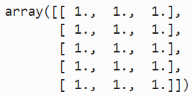

Data Type - numpy
Get the 1st and 3rd column of array $y$
Generating matrices with all the elements as zero
one
College of Engineering, Sungkyunkwan University

Slide 20










Data Type - numpy
Operations on matrices
Element by element multiplication
College of Engineering, Sungkyunkwan University

Slide 21




Data Type - numpy
Transpose of an array
Some numpy in-built mathematical functions
Logical operations on matrices
College of Engineering, Sungkyunkwan University

Slide 22


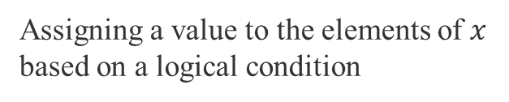
Data Type - numpy
Choosing elements based on a logical condition
Assigning a value to the elements of $x$ based on a logical condition
College of Engineering, Sungkyunkwan University

Slide 23
Assignment 2
Write a line of code that generates the following error:
NameError: name 'x' is not defined
Assign string ‘123’ to the variable S. Convert the string into a float type and assign the output to the variable N. Verify that S is a string and N is a float using the type function.
Use the print function to generate the following strings.
The word ‘Engineering’ has 11 letters.
The word ‘Book’ has 4 letters.
Get the last word ‘great’ from ‘Python is great!’.
Turn ‘Python is great!’ to a list.
Assign list [1, 8, 9, 15] to a variable list_a and insert 2 at index 1 using the insert method. Append 4 to the list_a using the append method.
Get the unique element from (2, 3, 2, 3, 1, 2, 5).
College of Engineering, Sungkyunkwan University

Slide 24
Assignment 2
Assign (2, 3, 2) to set_a, and (1, 2, 3) to set_b. Get the following:
union of set_a and set_b
intersection of set_a and set_b
difference of set_a to set_b
Create a dictionary that has the keys ‘A’, ‘B’, ‘C’ with values ‘a’, ‘b’, ‘c’ individually. Print all the keys in the dictionary.
Let array_a be an array [-1, 0, 1, 2, 0, 3]. Write a command that will return an array consisting of all the elements of array_a that are larger than zero. Hint: Use logical expression as the index of the array.
Create a zero array with size (2, 4) and change the 2nd column in the above array to 1.
Write a cell magic to clear all the variables in the Jupyter notebook
College of Engineering, Sungkyunkwan University

